Slide 1
Quantitative Research Methods
Matthew Ivory
matthew.ivory@lancaster.ac.uk

Slide 2
1. Introduction to the course
Session 1: Introduction to quantitative research methods using R
Session 2: Data management and data wrangling
Session 3: Exploratory data analysis
Session 4: Data visualization
Session 5: Live Coding Walkthrough
Session 6: Probability and distributions
Session 7: Tests for discrete variables: Analysing contingency tables
Session 8: Correlations and t-tests
Session 9: ANOVA and linear regression
Session 10: Multiple regression, introduction to generalised linear regression

Slide 3
Our plan for today
Exploratory data analysis (contd)
Data visualization
Short introduction
Handout 4

Slide 4
Discussion homework 3

Slide 5
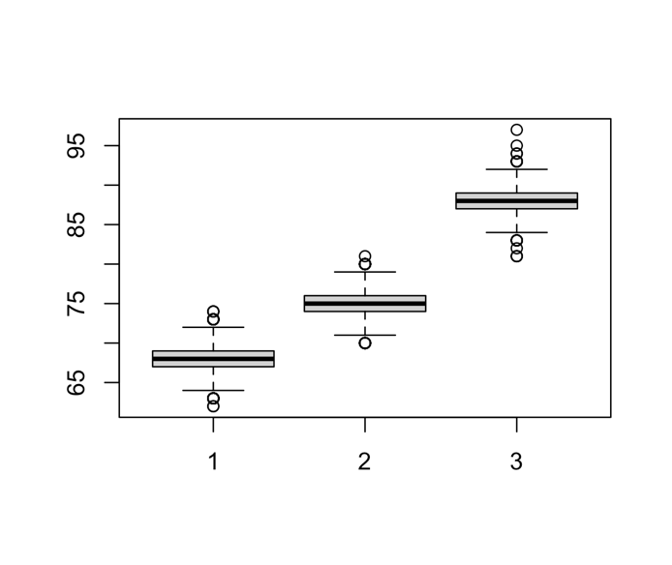
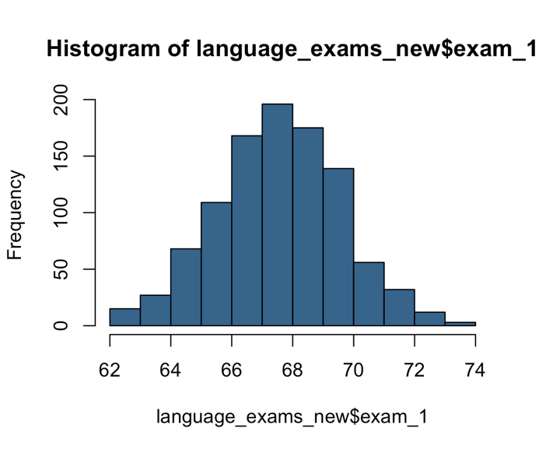
Steps 3 and 4
Exploratory data analysis
Mean, median, SD, range, quantiles, frequencies, etc.
Our first graphic explorations
Colors?

Slide 6
Exploratory data analysis

Slide 7
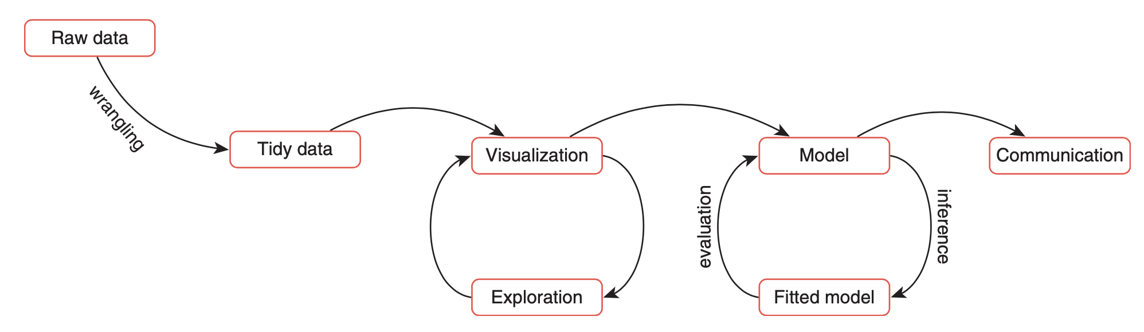
The Data Science Workflow
Reproduced from Andrews (2021)

Slide 8
Tukey (1977)
Exploratory data analysis
Aim: to discover potentially interesting patterns and behaviors in the data.
Confirmatory data analysis:
Aim: to propose and test models of our data
Image reproduced from here.

Slide 9
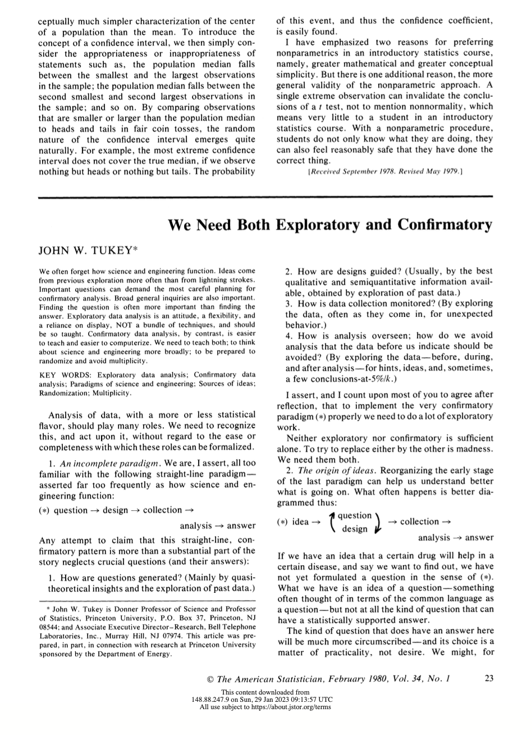
Tukey (1980)
“Exploratory data analysis is an attitude, a flexibility, and a reliance on display, NOT a bundle of techniques, and should be so taught.

Slide 10
Hartwig & Dearling (1979)
“Exploratory data analysis is a state of mind, a way of thinking about data analysis (…).”
Assumption: The more we know about the data, the more effectively data can be used to develop, test and refine theory.
Examples of EDA in your field?

Slide 11
Hartwig & Dearling (1979)
The explanatory seeks to maximize what can be learned from data.
This requires two things:
Skepticism
Openness
What do you think this means?
Notes:
This requires two things:
Skepticism (towards measures which summarize data as they can conceal or misrepresent)
Openness (to unanticipated patterns in the data)

Slide 12
Data visualization

Slide 13
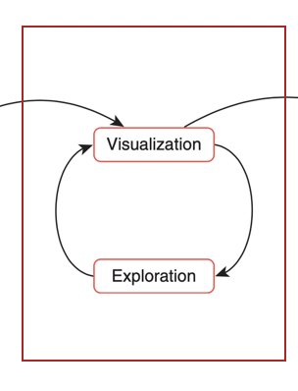
What is data visualization?
The graphic representation of data and information
An essential component of EDA and CDA

Slide 14
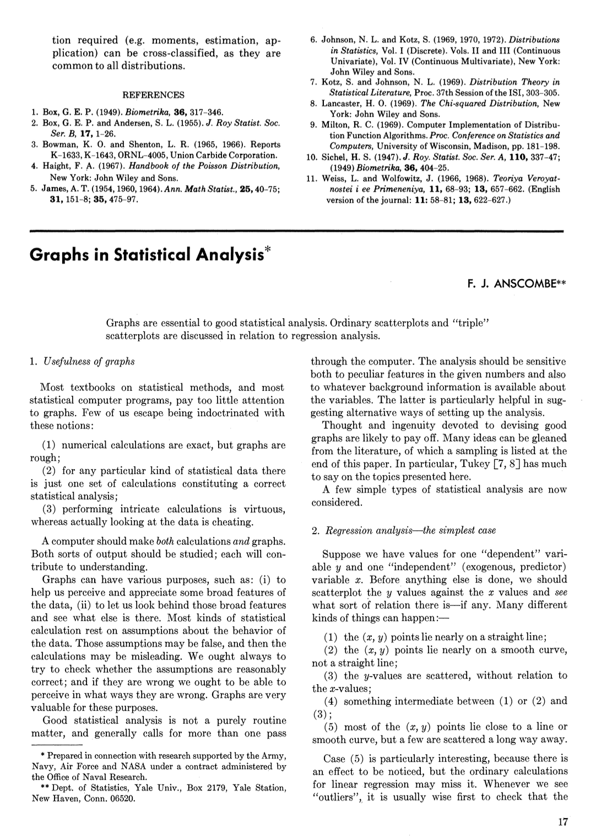
Anscombe’s Quartet
Anscombe (1973) illustrates beautifully why we cannot rely solely on numerical summaries.
Anscombe created four data sets, each with two variables (x, y).

Slide 15
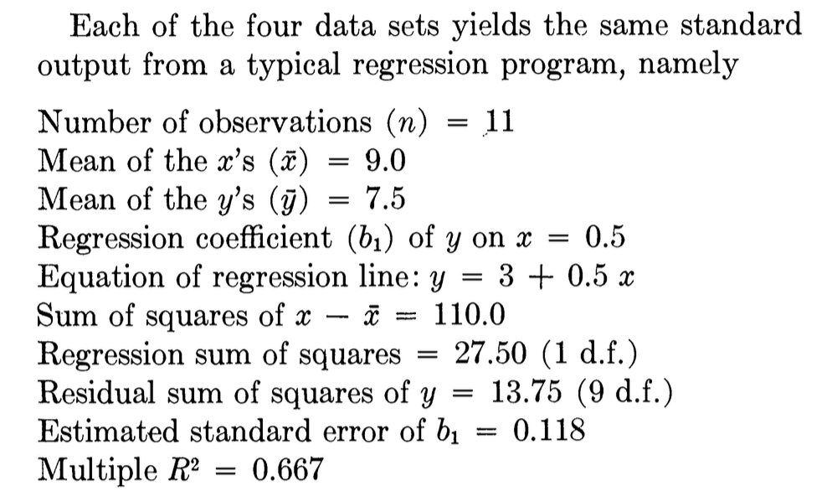
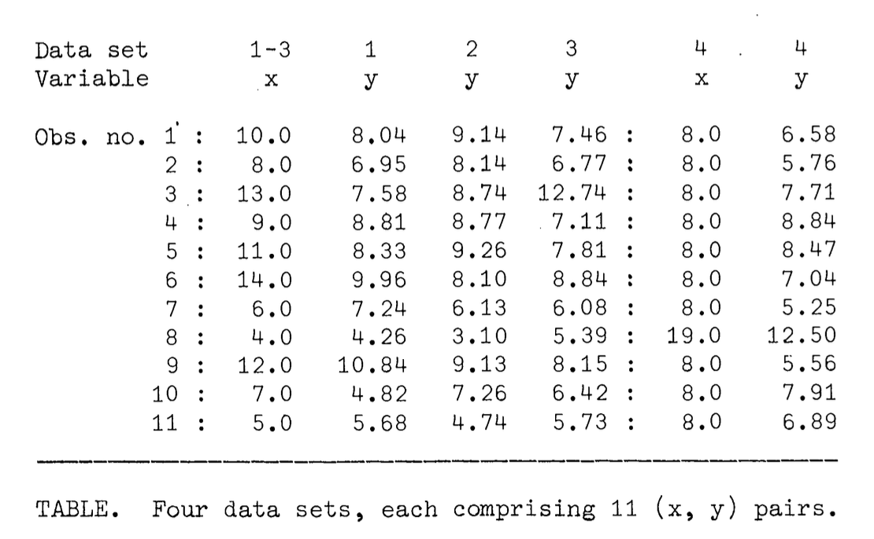
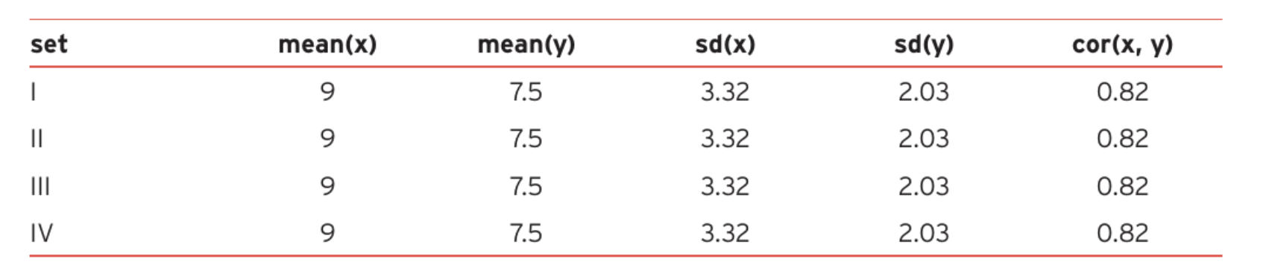
Anscombe’s Quartet
Data sets
The numerical summary statistics would suggest that the data in these sets would be very similar!
The summary statistics for the data sets above

Slide 16
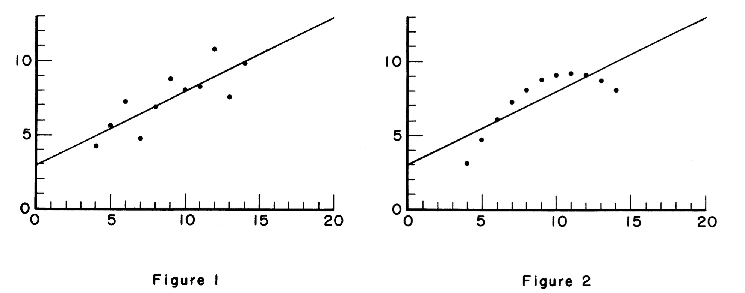
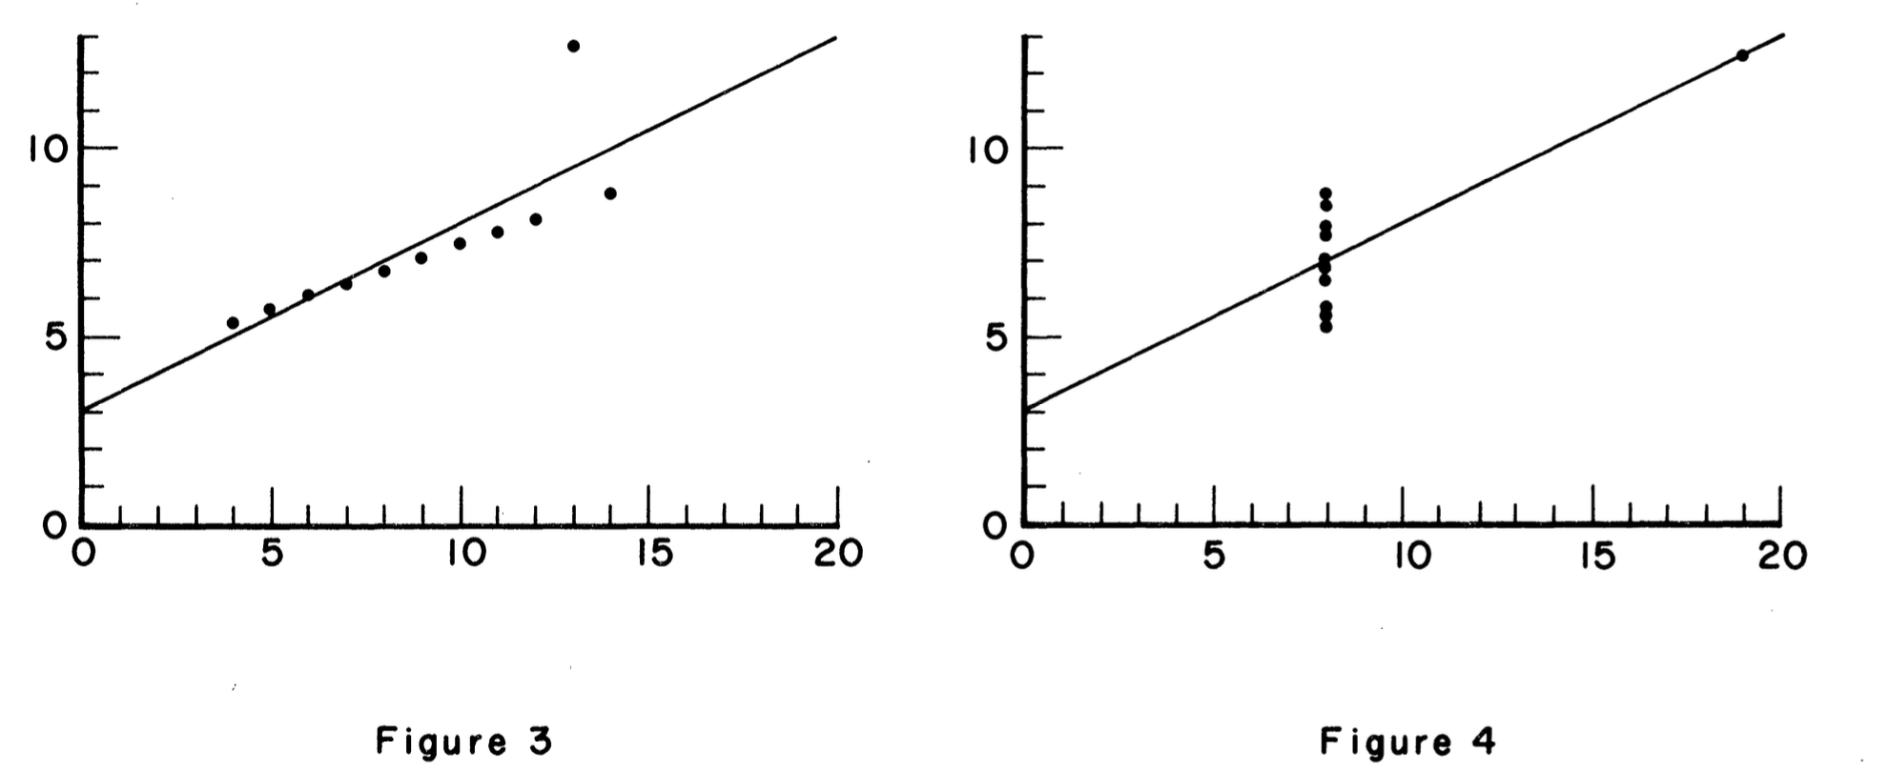
But…
Tukey (1977): Visualization “forces us to notice what we never expected to see.”

Slide 17
We use visualization twice (at least)
Reproduced from Andrews (2021)
Notes:
It is about enhanced understanding
First for our own understanding
and then for improving the understanding of everyone else

Slide 18
Data visualization in EDA
Here, visualization allows us to explore data and find patterns that we can easily miss if we just rely on numerical summary statistics.
Outliers
Whisker
Upper quartile
Interquartile range
Median
Lower quartile
Whisker
Outliers

Slide 19
Data visualization in CDA
We use graphics in publications and presentations.
There are numeric techniques which are almost always displayed in visual form. Usually applies to techniques that model multivariate relationships.
Example: The results of structural equation modeling (SME) are usually represented in the form of dendrograms.

Slide 20
Godfroid and Kim (2021)

Slide 21
Historical perspective

Slide 22
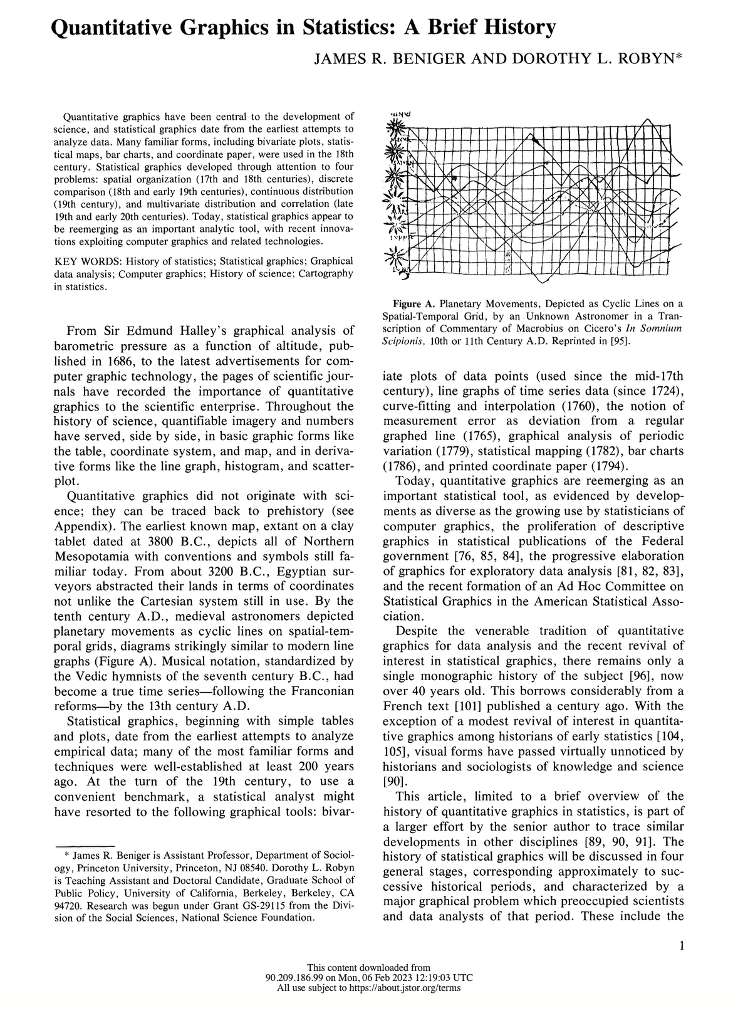
Statistical graphics have been around for many centuries.
c. 3,800 BC: Oldest known map (Northern Mesopotamia) on clay tablet
1786: Bar chart (William Playfair)
1801: Pie chart (William Playfair)
1833: Histogram (A. M. Guerry)
1874: Age pyramid (bilateral histogram) (Francis A. Walker)

Slide 23
Beninger and Robyn (1978)
Development of statistical graphics as solutions to major graphical problems that occupied scientists at the time.

Slide 24
18th century: How to represent State statistics?
William Playfair (1786): Exports and Imports of Scotland to and from different parts for one Year from Christmas 1780 to Christmas 1781
Notes:
Visual data displays have become far more common and elaborate as the power of computer graphics has evolved. But it would be a mistake to assume that displaying data visually is a new thing. One early author who made extensive use of data graphics was the economist William Playfair in the 1780s. Here you have an example of one of his bar charts, showing exports/imports of different commodities from and into Scotland.
William Playfair (1786): Exports and Imports of Scotland to and from different parts for one Year from Christmas 1780 to Christmas 1781

Slide 25
19th century: How to represent vital statistics?
Florence Nightingale (1858): Diagram of the causes of mortality in the army in the East
Notes:
Polar chart by Florence Nightingale, 1858
Florence Nightingale (1858): Diagram of the causes of mortality in the army in the East
Another fairly early user of statistical graphics was Florence Nightingale. She is best known as a pioneer in nursing, but she also did extensive statistical work on disease incidence in the British army during the Crimean War. This is one of her graphs. This kind of graph is sometimes known as a rose plot, and it is a variant of the better known pie chart, which we shall meet shortly.

Slide 26
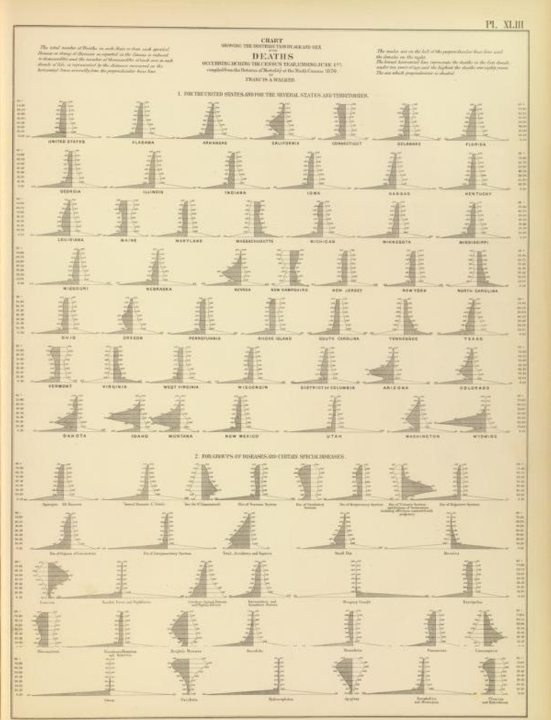
19th century: How to represent vital statistics?
Francis A. Walker (1874): Age pyramid
(bilateral histogram)
Notes:
Polar chart by Florence Nightingale, 1858
Florence Nightingale (1858): Diagram of the causes of mortality in the army in the East
Another fairly early user of statistical graphics was Florence Nightingale. She is best known as a pioneer in nursing, but she also did extensive statistical work on disease incidence in the British army during the Crimean War. This is one of her graphs. This kind of graph is sometimes known as a rose plot, and it is a variant of the better known pie chart, which we shall meet shortly.

Slide 27
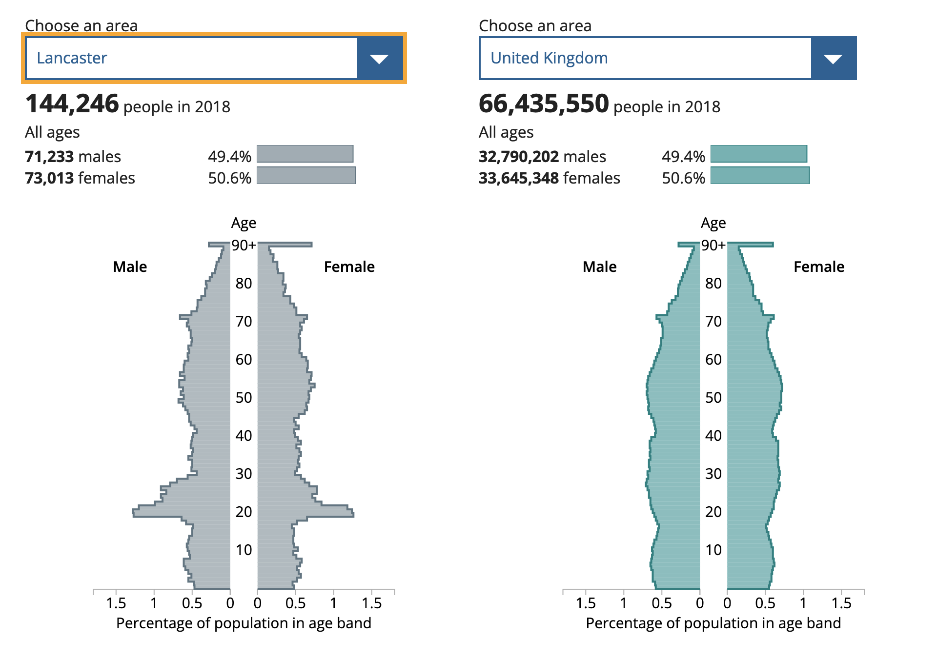
Age pyramids
1874: Age pyramid (bilateral histogram) (Francis A. Walker)
ONS data, click here

Slide 28
19-20th century: How to represent multivariate relationships?
Vauthier (1874): Population contour map.
Map of Paris with population density depicted as contour lines.

Slide 29
19-20th century: How to represent multivariate relationships?
Luigi Perozzo (1879): Stereogram
3D population pyramid representing Swedish population (1750-1875) by age groups)

Slide 30
Some guiding principles
Look at your data from different ways and from different perspectives, compare finer and coarser levels.
Notes:
Look at it from different ways, from different perspectives, finer and coarser levels.

Slide 31
Tufte (1983): Visual display of quantitative information
Above all else show the data
Avoid distorting what the data have to say
Encourage the eye to compare different pieces of data
Reveal the data at several levels of detail, from a broad overview to the fine structure

Slide 32
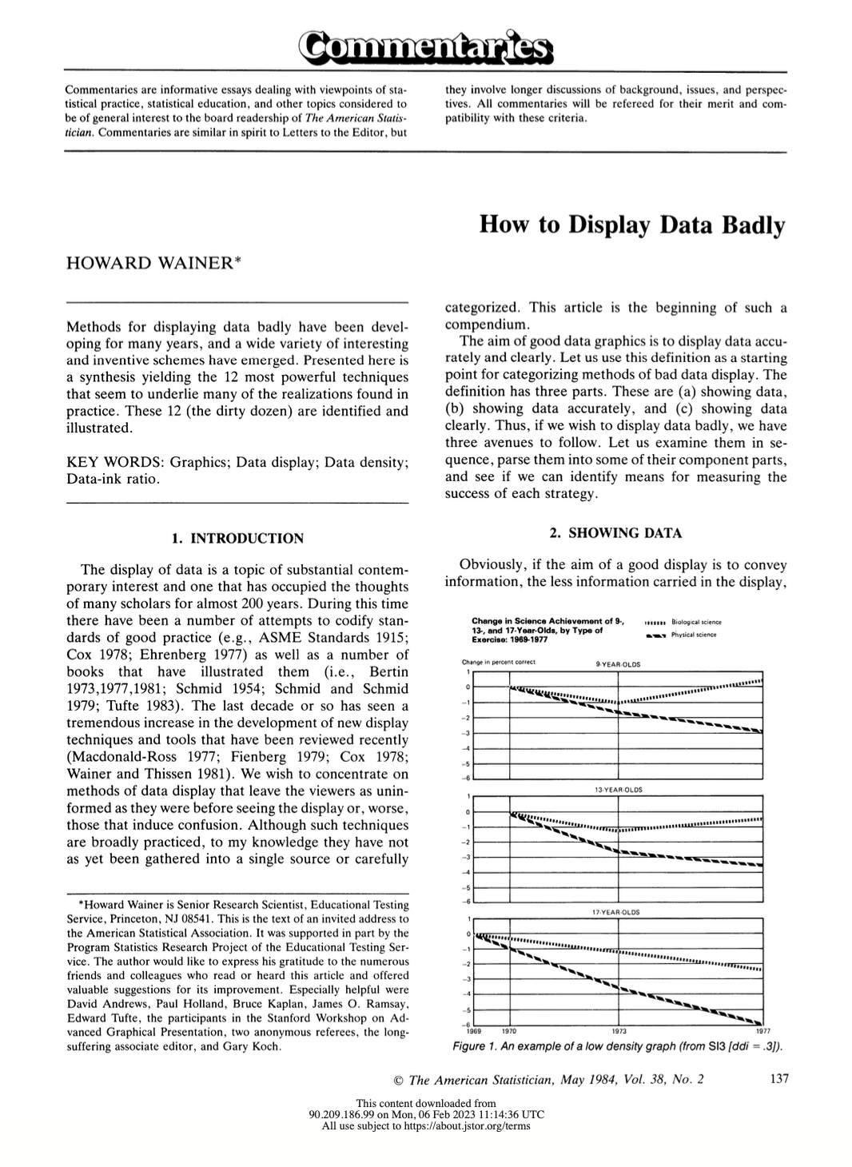
Wainer (1984): How to display data badly
Among the 12 rules:
Show as few data as possible (minimize the data density)
Hide what data you want to show
Change scales in mid-axis
Emphasize the trivial (ignore the important)
If it has been done well in the past, think of another way to do it

Slide 33
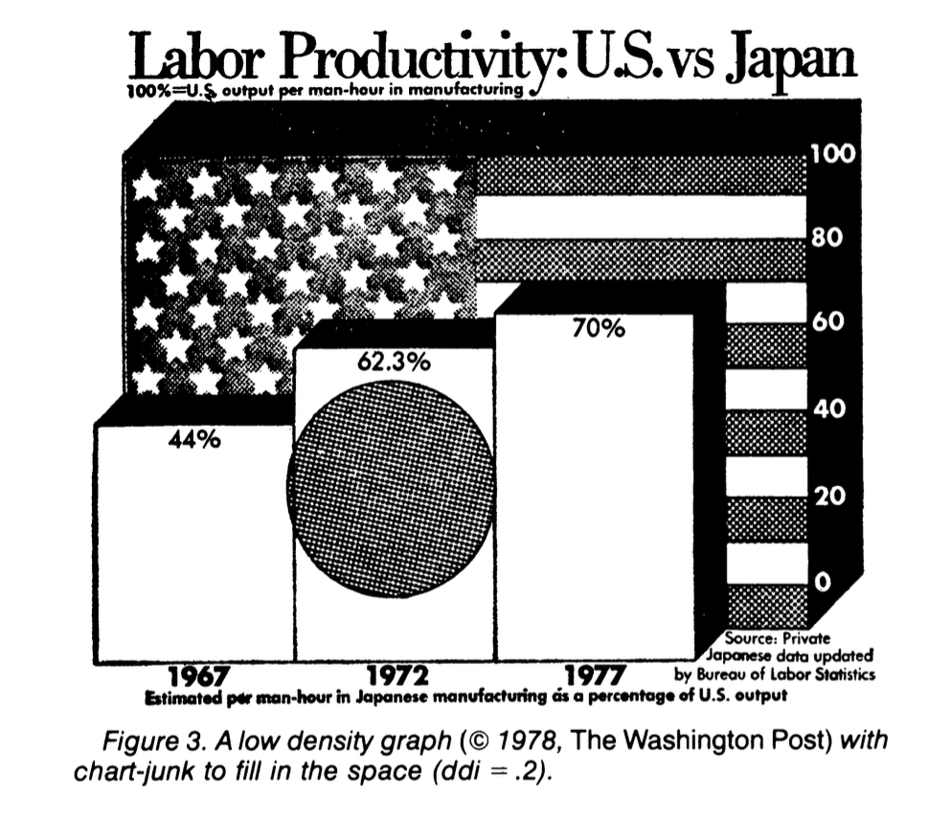
Wainer (1984)
Data density index (ddi): The number of numbers plotted per square inch.” (Tufte, 1983)
Show as few data as possible (minimize the data density)

Slide 34
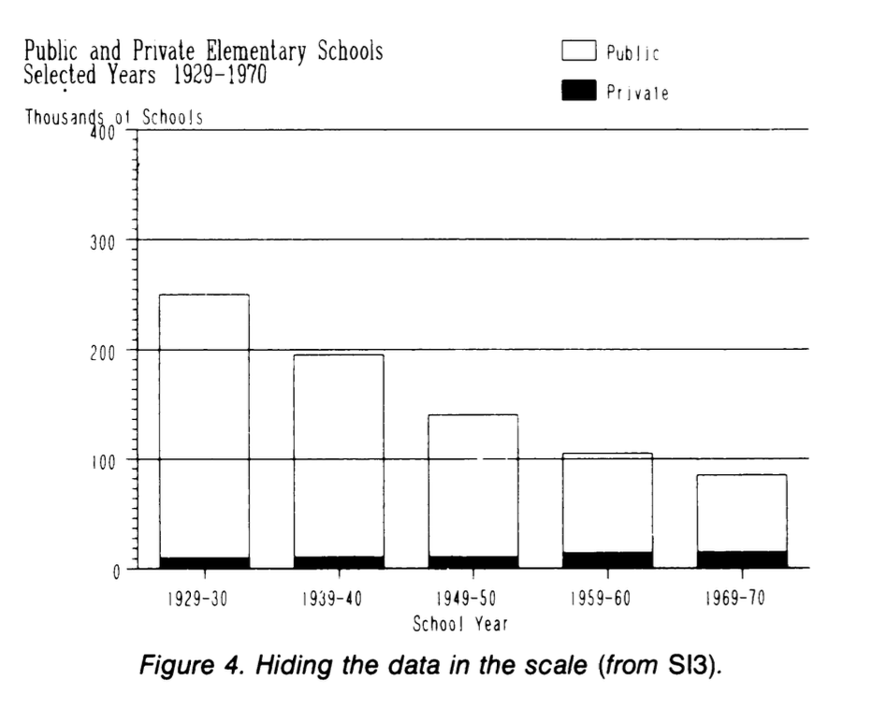
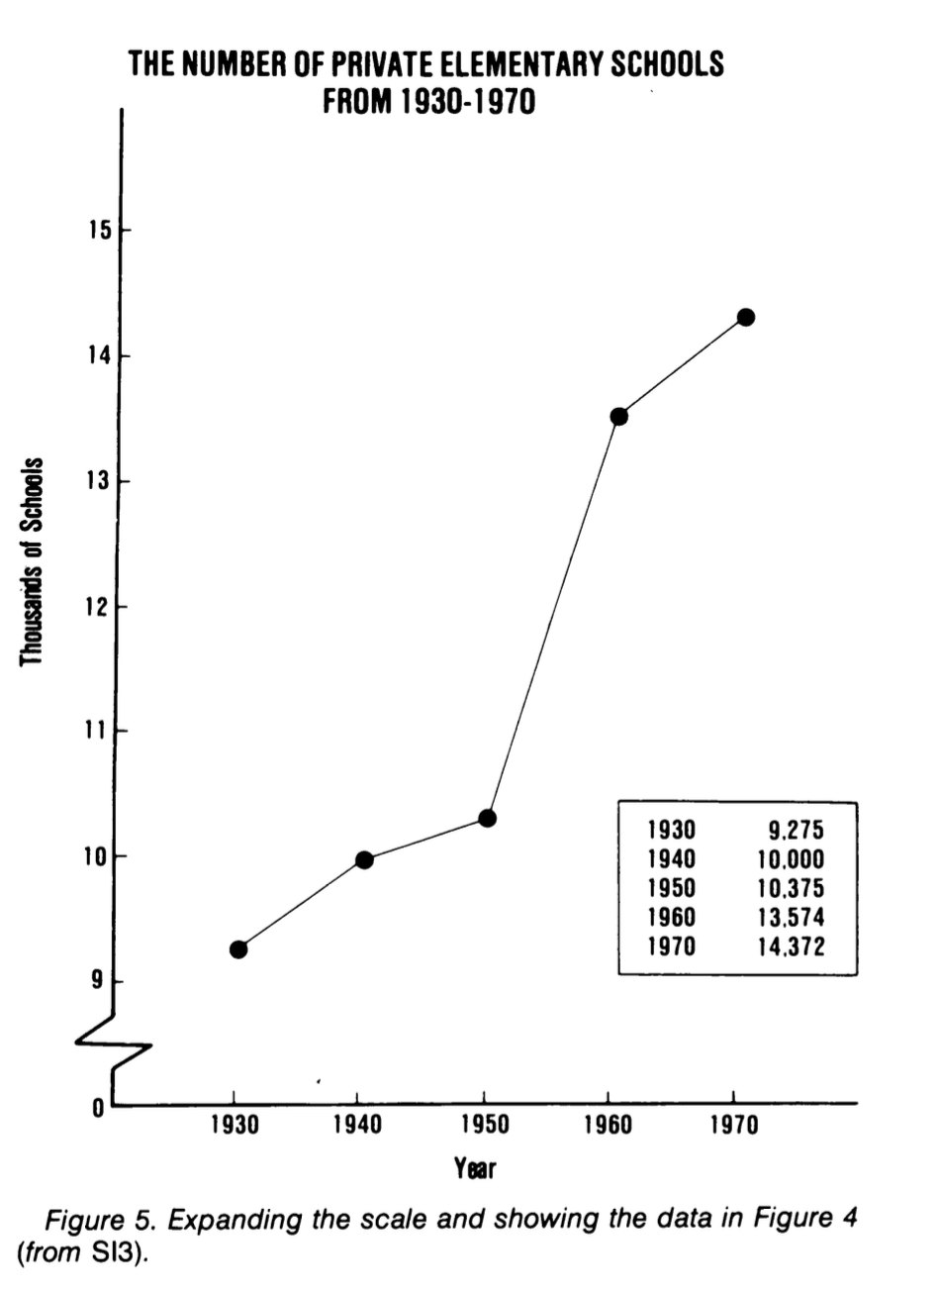
Wainer (1984)
Hide what data you want to show

Slide 35
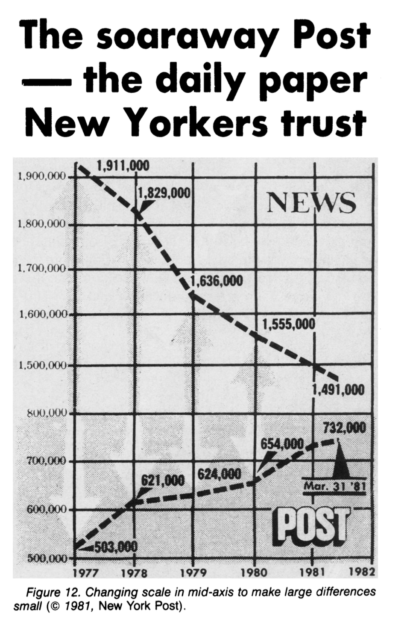
Wainer (1984)
Change scales in mid-axis

Slide 36
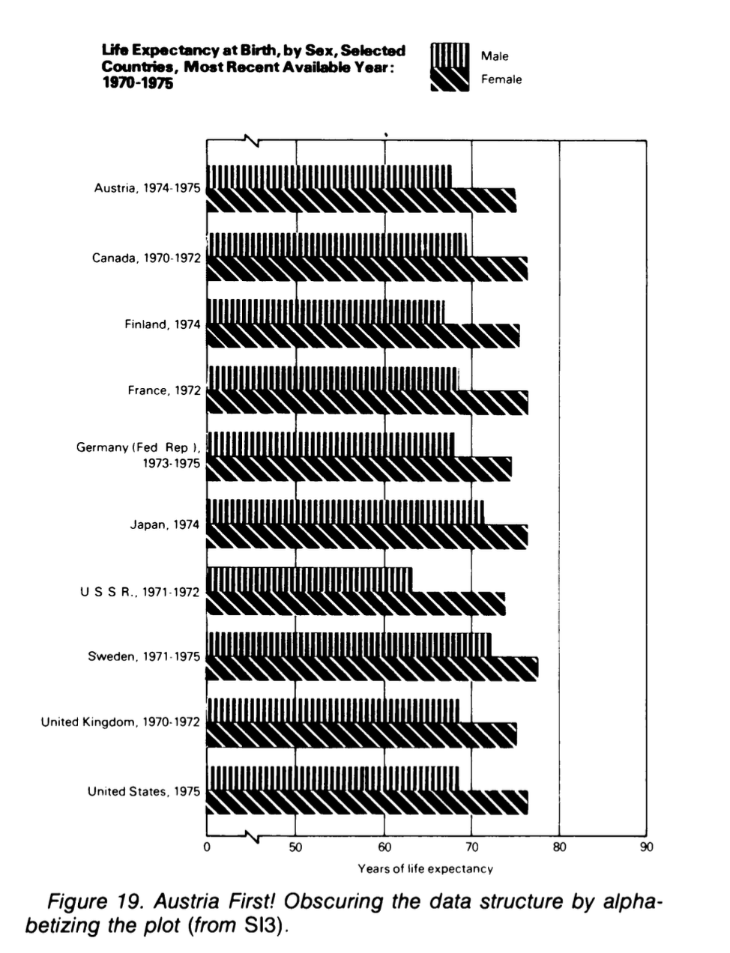
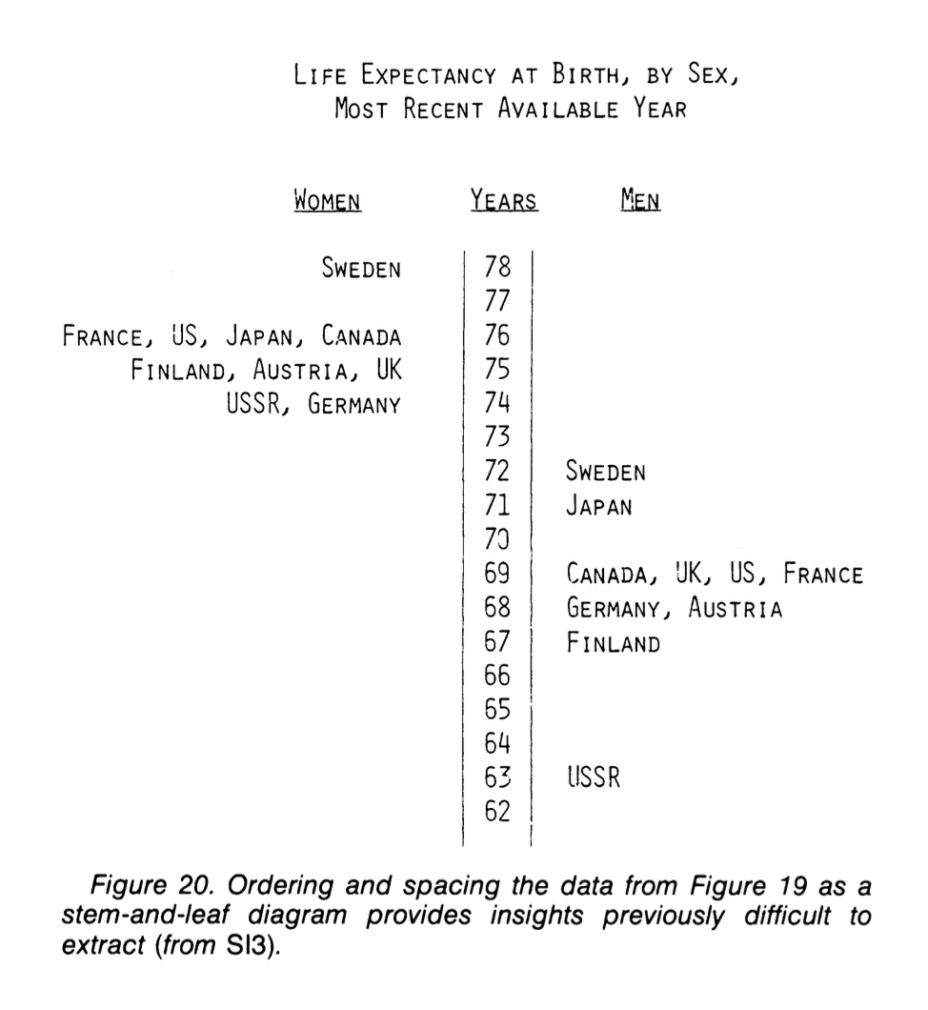
Wainer (1984)

Slide 37
Some common type of graphics

Slide 38
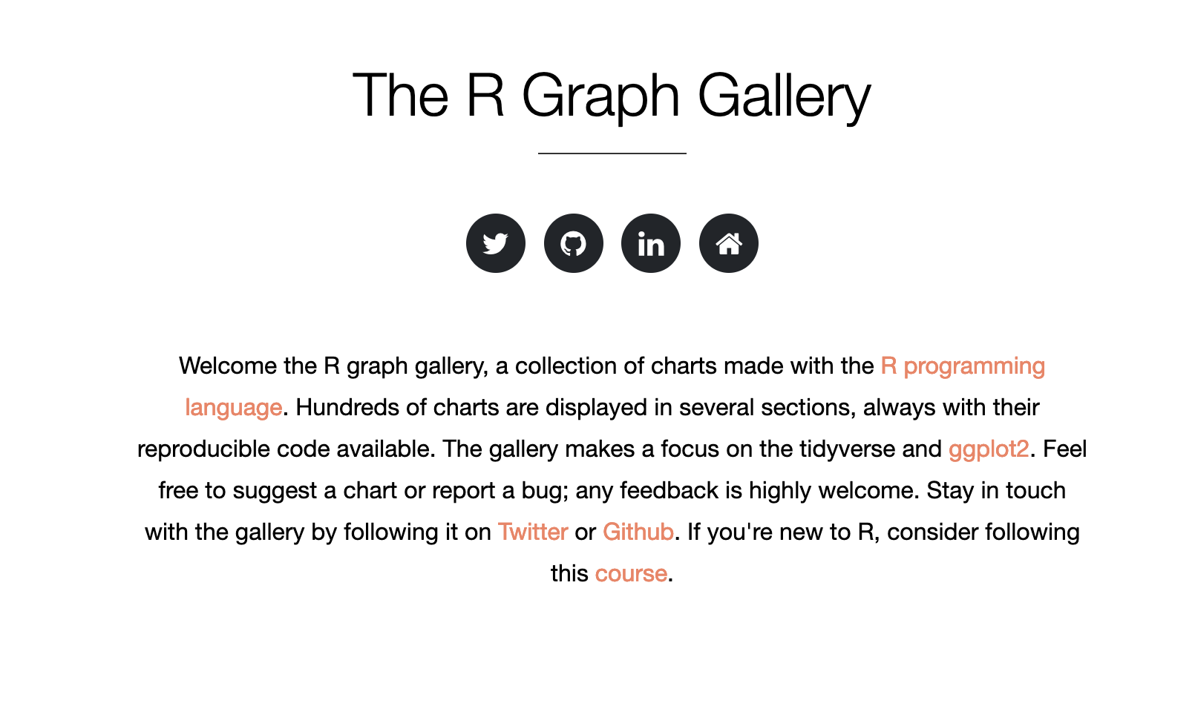
Some common type of graphics
Text here

Slide 39
Some common types of graphics
Bar chart (simple and stacked)
Pie charts
Histograms
Scatterplots
Line graphs
Box plots
Notes:
We are now going to take a look at some of the commoner types of graphs in quantitative research. We’ll see what they are used for, and consider (where relevant) some of the issues for and against them.

Slide 40
A few practicalities

Slide 41
Cost and use of color
Some publishers charge you $$$$ for including graphics, so read the “small print” carefully before you submitting your manuscript.
Color looks nice on screen, but it doesn’t photocopy or print well.
Also, publishers also often charge extra $$$$ for colored graphics.
So, it is often best to stick to monochrome fill patterns in these cases.
Notes:
When considering whether or how to include graphical displays in your own work, it is important to think about the practicalities.

Slide 42
Clear labeling
Always label your graphs carefully and informatively with a suitable caption.
Add labels to your axes on graphs.
Show what the scale and unit of measurement is as well (e. raw numbers vs percentages).
If using color or shading: Add an explanatory chart to show what each means.
Notes:
When considering whether or how to include graphical displays in your own work, it is important to think about the practicalities.
It may seem obvious, but make sure that your choice of graphic is appropriate for both the variable type (continuous vs. discrete) and the kind of information that you want to show (e.g. distribution shape, proportional frequencies, interaction of two variables, time series, etc.).

Slide 43
Selection of scale
Choose the scale of the graph carefully.
Most software defaults to using the observed range of a variable as the scale for the relevant axis.
Sometimes this is OK, but it can also make the gradient of a trend line look more “impressive” than it actually is.
Compare the following…
Notes:
When considering whether or how to include graphical displays in your own work, it is important to think about the practicalities.
It may seem obvious, but make sure that your choice of graphic is appropriate for both the variable type (continuous vs. discrete) and the kind of information that you want to show (e.g. distribution shape, proportional frequencies, interaction of two variables, time series, etc.).

Slide 44
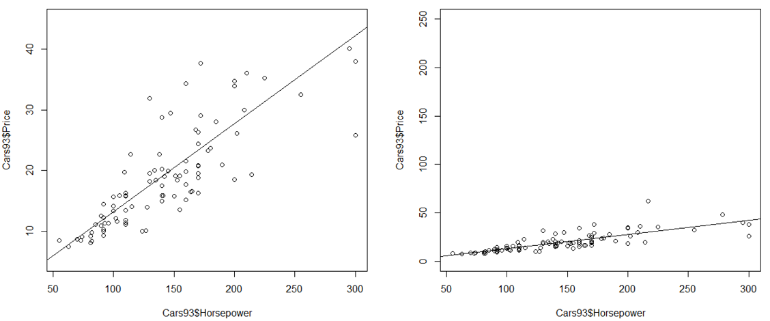
Same data, different range of y-axis
Text here
Notes:
Note the difference in y axis limits

Slide 45
Avoid duplication
Don’t use different kinds of plot to do the same “job” within the same article.
Common mistake in undergraduate dissertations, e.g. students might use both bar charts and pie charts for the same data.
Readers are interested in the data, not our virtuosity in using a graphics package
Notes:
When considering whether or how to include graphical displays in your own work, it is important to think about the practicalities.
It may seem obvious, but make sure that your choice of graphic is appropriate for both the variable type (continuous vs. discrete) and the kind of information that you want to show (e.g. distribution shape, proportional frequencies, interaction of two variables, time series, etc.).

Slide 46
What do other people do?
You need to be aware of the reporting practices in your field.
How do other researchers (those who publish now in leading peer-reviewed journals) display their data?
Pay special attention to studies who use the same data or research instruments.
Notes:
When considering whether or how to include graphical displays in your own work, it is important to think about the practicalities.
It may seem obvious, but make sure that your choice of graphic is appropriate for both the variable type (continuous vs. discrete) and the kind of information that you want to show (e.g. distribution shape, proportional frequencies, interaction of two variables, time series, etc.).

Slide 47
Examples: what can you plot?

Slide 48
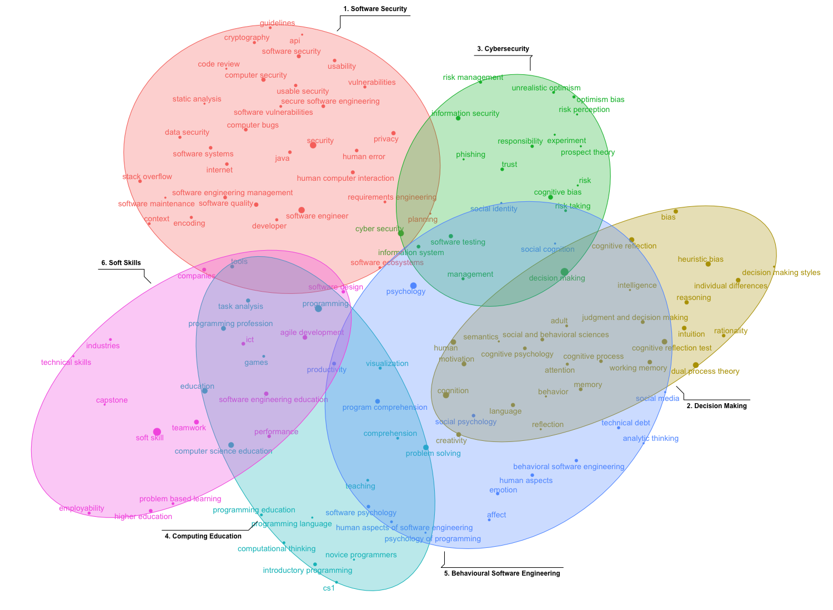

Slide 49
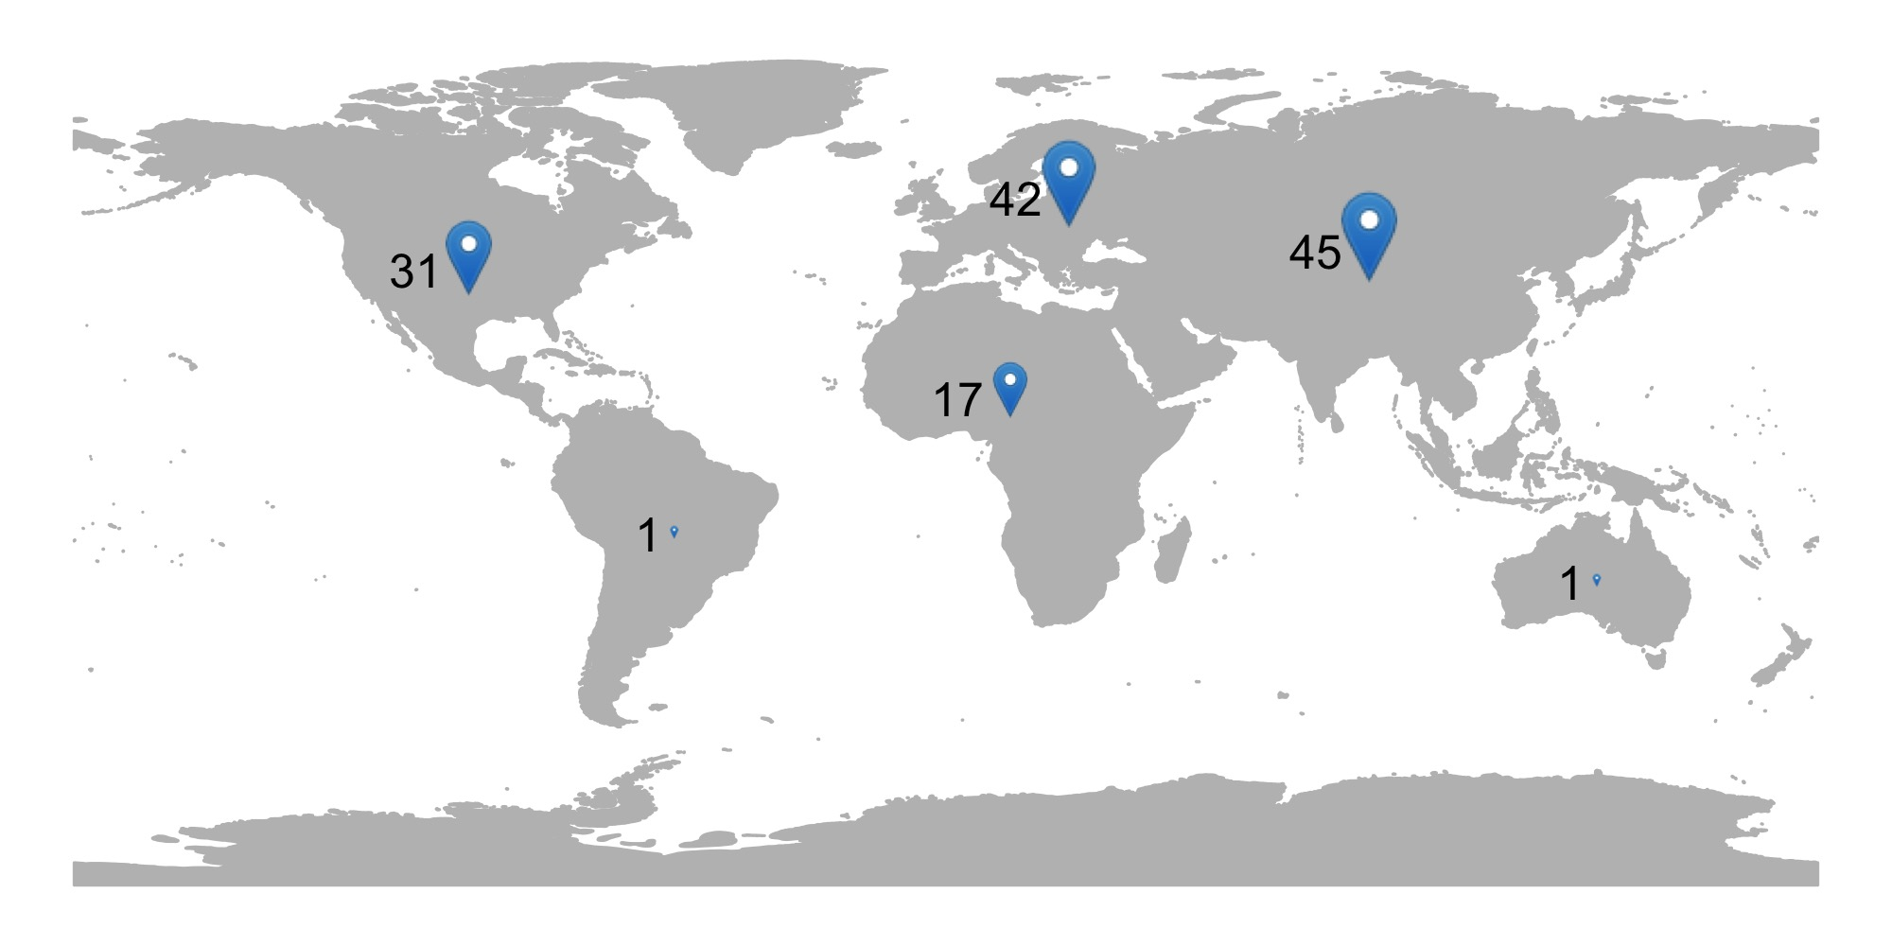

Slide 50
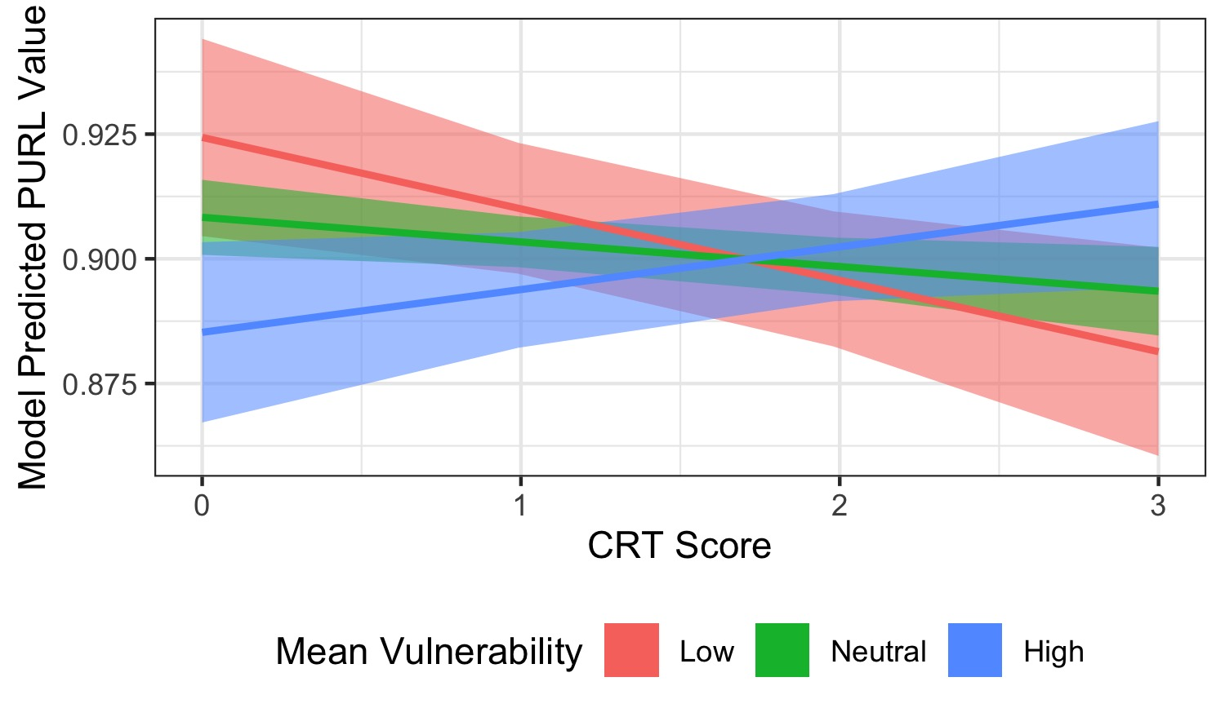

Slide 51
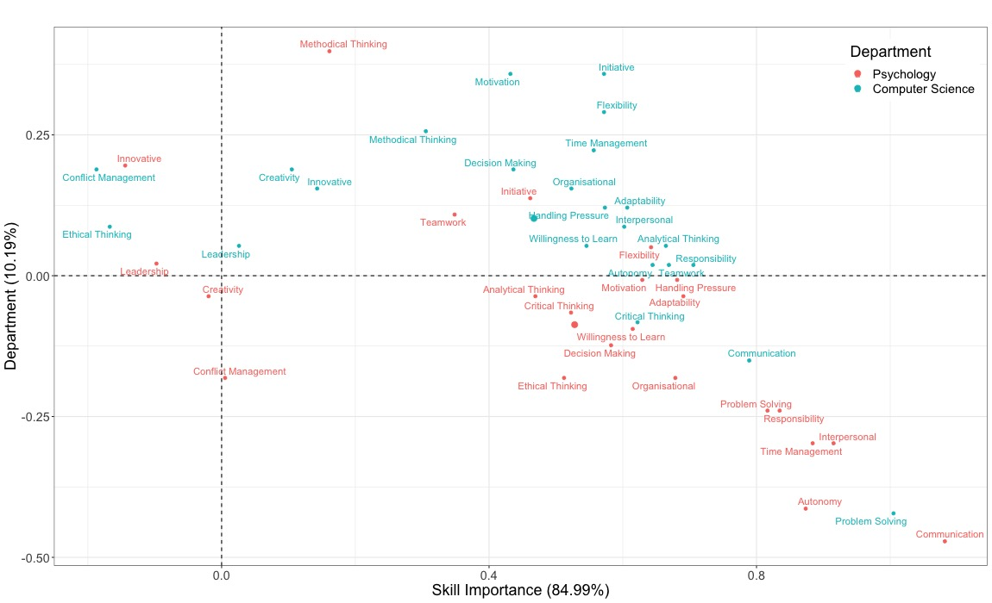

Slide 52
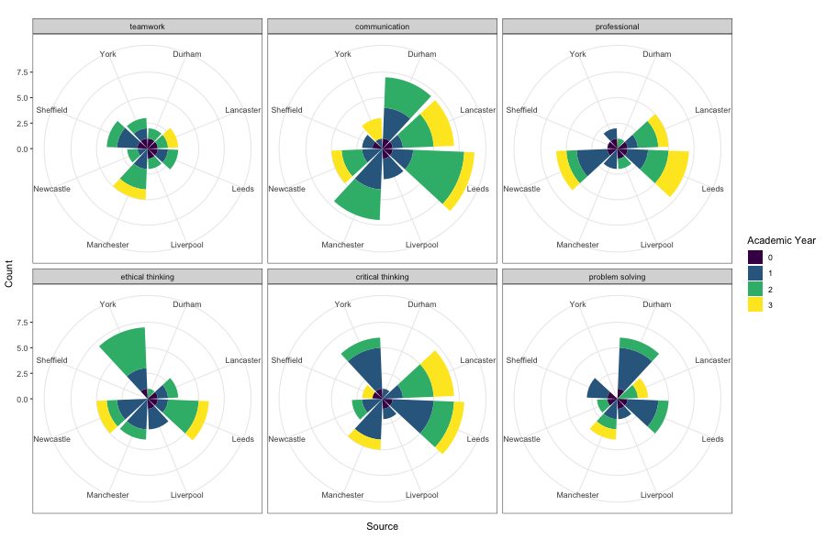

Slide 53
Practical: Data visualization

Slide 54
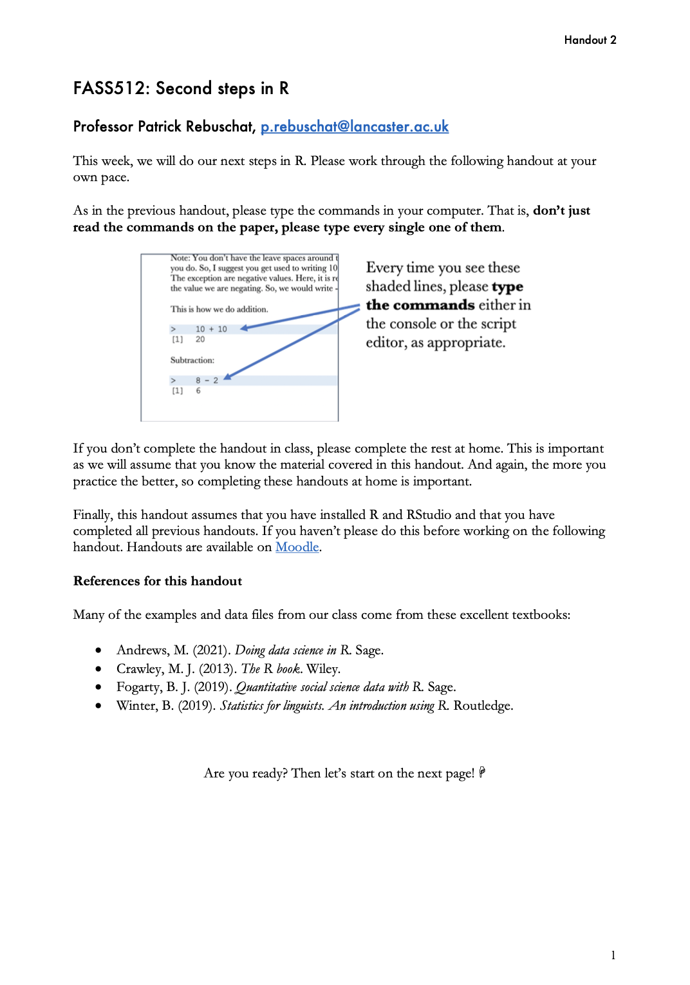
Handout 4
Aim: Introduce you to two plotting systems in R, base R and ggplot.
ggplot is the most-widely used plotting system.
Notes:
This week, we will do our first steps in R. Please work through the following handout at your own pace.
Three important things to remember:
As you complete the handout, please type the commands in your computer. (The commands are highlighted in the document below.) That is, don’t just read the commands on the paper, please type every single one of them. This is really important: Learning to program is like practicing a conversation in a new language. You will improve gradually, but only if you practice.
If you’re stuck with something, please write down your questions (to share later in class) and try to solve the problem. Please ask your group members for support and, conversely, if another student is stuck, please try to help them out, too. This way, we develop a supportive learning environment that benefits everybody. In addition, get used to the Help pages in RStudio and start finding solutions online (discussion forums, online textbooks, etc.). This is really important, too. You will only really know how to do quantitative research and statistical analyses when you are doing your own research and dealing with your own data. At that point, you need to be sufficiently autonomous to solve problems, otherwise you will end up making very slow progress in your PhD.
Finally, if you don’t complete the handout in class, please complete the handout at home. This is important as we will assume that you know the material covered in this handout. And again, the more you practice the better, so completing these handouts at home is important.

Slide 55
Handout 4: Web resources
An excellent reference for ggplot
A useful cheat sheet
Gorgeous graphs in ggplot
Notes:
This week, we will do our first steps in R. Please work through the following handout at your own pace.
Three important things to remember:
As you complete the handout, please type the commands in your computer. (The commands are highlighted in the document below.) That is, don’t just read the commands on the paper, please type every single one of them. This is really important: Learning to program is like practicing a conversation in a new language. You will improve gradually, but only if you practice.
If you’re stuck with something, please write down your questions (to share later in class) and try to solve the problem. Please ask your group members for support and, conversely, if another student is stuck, please try to help them out, too. This way, we develop a supportive learning environment that benefits everybody. In addition, get used to the Help pages in RStudio and start finding solutions online (discussion forums, online textbooks, etc.). This is really important, too. You will only really know how to do quantitative research and statistical analyses when you are doing your own research and dealing with your own data. At that point, you need to be sufficiently autonomous to solve problems, otherwise you will end up making very slow progress in your PhD.
Finally, if you don’t complete the handout in class, please complete the handout at home. This is important as we will assume that you know the material covered in this handout. And again, the more you practice the better, so completing these handouts at home is important.

Slide 56
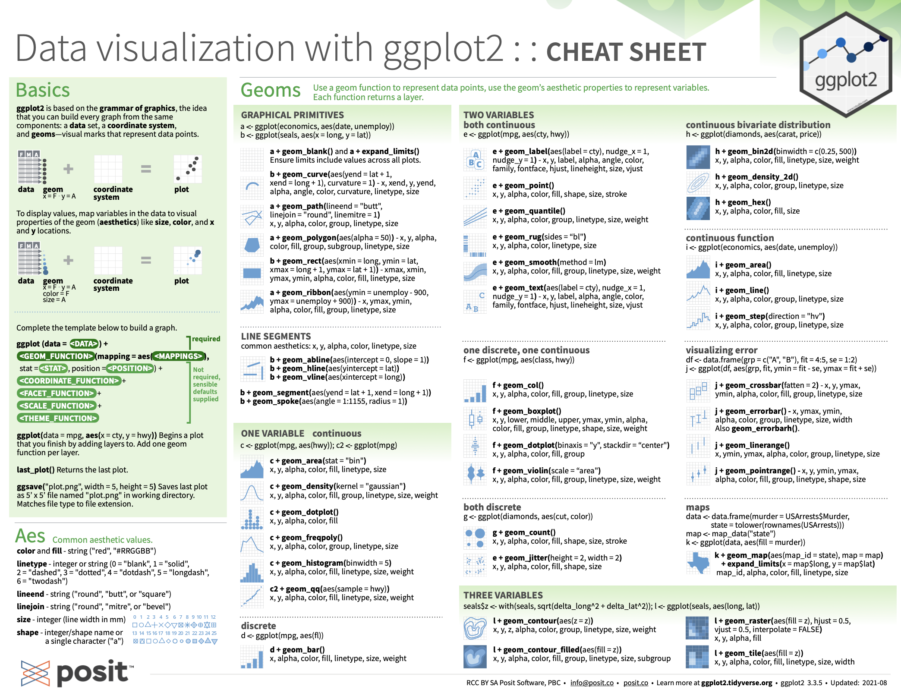
Placeholders
Text here

Slide 57
Questions?
I will be walking around while you work through the worksheet

